Slide 1


Department of Artificial Intelligence and Data Science
SmartSpace: Transforming Retail Shelves with Market Basket Analysis
Supervisor
Dr.V.Saravanakumar
SAI NARAYAN R (221801042)
SANJAY B (221801045)
SOORYA B (221801051)

Slide 2
Problem Statement and Motivation
A grocery chain wants to optimize shelf space utilization by analyzing sales data and customer shopping patterns. They aim to improve product placement and inventory management.
□ By organizing shelves better, stores can sell more of what customers want, making more money.
□ Using sales info and shopper behavior helps stores decide which products to stock and where to put them.
□ Organizing shelves efficiently saves time and effort in restocking and managing inventory.

Slide 3
Objectives
The objective is to optimize shelf space utilization in the grocery chain by leveraging sales data and customer shopping patterns. This will involve analyzing product performance and consumer behavior to enhance product placement strategies, ensuring that high-demand items are easily accessible and well-stocked. The goal is to maximize sales, improve inventory management, and increase customer satisfaction.

Slide 4
Abstract
Optimizing shelf space utilization in a grocery chain requires a strategic approach grounded in the analysis of sales data and customer shopping patterns. aims to enhance product placement by leveraging insights from product performance and consumer personas. the goal is to improve the accessibility and availability of high-demand items, increase sales, reduce stockouts, and ensure efficient inventory turnover. The outcomes of this analysis will offer actionable strategies for more effective analysis and inventory practices within the grocery chain.

Slide 5
Introduction and Overview of the Project
Customer Behavior Analysis for Efficient Shelf Space Management is crucial for optimizing retail environments.
Current methods often suffer from inaccurate data and inefficient analysis tools.
Implement a system with advanced analytics and automated data collection and enable adjustments based on real-time customer behavior, maximizing sales potential.

Slide 6
Literature Survey
Grocery shelf optimization has been extensively studied to enhance profitability and customer satisfaction. Huang et al. [1] and Tsai and Huang [2] utilized data mining techniques to optimize shelf space by analyzing customer behavior and movement patterns. Heikal and Gandhi [3] applied market basket analysis to develop strategies for diverse consumer needs, while Agarwal et al. [4] and Mulkan [5] leveraged the Apriori algorithm to improve store layouts and product placement. David [6] further demonstrated its use in enhancing in-store experiences through shopping pattern analysis.

Slide 7
S.No | Author Name | Paper Title | Description | Journal | Volume/ Year
1 | Sheng-Hsiang Huang, Chieh-Yuan Tsai, Chih-Chung Lo | A Multi-Data Mining Approach for Shelf Space Optimization Considering Customer Behaviour | The paper focuses on utility mining to enhance product profitability and solve the product-to-shelf assignment problem using consumer behavior data. | 11th International Conference on e-Business (ICE-B-2014) | 2014
2 | Chieh-Yuan Tsaiab, Sheng-Hsiang Huang | A data mining approach to optimize shelf space allocation in considering customer purchase | The paper proposes a three-stage data mining method to optimize retail shelf space by analyzing customer purchase and movement patterns. | Expert Systems with Applications (2013) | 2015
3 | Jerry Heikal, Ayu Gandhi | Enhancing Retail Supermarket Financial Performance Through Market Basket Analytics | This paper explores the application of Market Basket Analysis to identify product strategies to diverse consumer personas | Business and Retail Management Research (2021) | 2024

Slide 8
Literature Survey
S.No | Author Name | Paper Title | Description | Journal | Volume/ Year
4 | Pragya Agarwal, Madan Lal Yadav, Nupur Anand | Study on Apriori Algorithm and its Application in Grocery Store | The paper discusses the Apriori algorithm and examines improvements to enhance grocery store data analysis. | International Journal of Computer Applications Volume 74, No.14, July 2013 | 2013
5 | Balya Ibnu Mulkan | An approach to improve layout store and product placement using Apriori algorithm | The paper discusses improving store layout and product placement using a combination of the Apriori algorithm and Profited Sequential Pattern | International Program, Department of Industrial Engineering, Universitas Islam Indonesia, in 2018. | 2018
6 | Ioana David | Improving the Customers’ In-Store Experience using Apriori Algorithm | The paper discusses About improving the customers experience through apriori algorithm and keeps monitoring on the shopping patterns | Department of Economic Informatics and Cybernetics Database Systems Journal, vol. X/2019 | 2019

Slide 9
Existing System
Currently, stores rely on employees observing customer behavior and making decisions based on their observations.
Use of traditional methods like paper records or basic spreadsheets for tracking sales and inventory.
Inability to quickly adjust product placement or inventory levels in response to changing customer preferences or market conditions.

Slide 10
Drawback of Existing System
Depending on people to track and restock shelves leads to
mistakes and slow updates.
Products are placed in the same spots without using sales data
or how customers shop.
Not using shelf space in the best way to sell more products.
Difficulty in quickly adjusting product placement or inventory levels in response to changing customer preferences or market conditions.

Slide 11
Proposed System
The proposed system uses the Apriori algorithm to optimize product placement in a grocery chain. By analyzing sales and customer behavior data, it identifies which products are frequently bought together,This approach ensures better use of shelf space and boosts sales by positioning high-demand items where they are most accessible. The system also reduces errors and ensuring popular products are always available. Continuous monitoring allows the system to adapt to changing shopping patterns, making shelf space more efficient and responsive to customer needs.

Slide 12
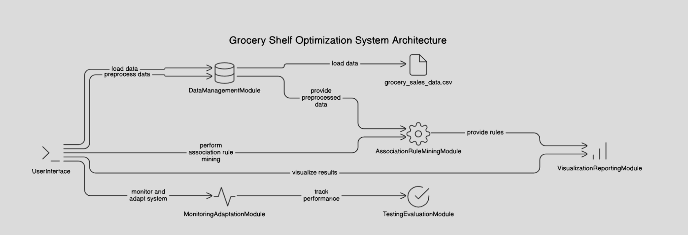
System Architecture

Slide 13
List of modules
Data Management Module: Collect, integrate, clean, and preprocess sales, customer, and inventory data.
Association Rule Mining Module : Use the Apriori algorithm to identify items and optimize product placement and restocking.
Visualization and Reporting Module: Create visualizations and reports for product placement and inventory insights.
Monitoring and Adaptation Module: Continuously adjust recommendations based on real-time data and changing patterns.
User Interface: Develop an interface, integrate with existing systems, and deploy the solution.
Testing and Evaluation Module: Test performance, gather feedback, and refine the system as needed.

Slide 14
Module 1 : Data Management Module
Step 1: Load the Data
The first step involves loading the dataset, specifically "grocery_sales_data.csv".
Step 2: Clean and preprocess the data
This crucial step includes:
Removing inconsistencies in the data.
Handling missing values.
Structuring the data for analysis.
Step 3: Cleaned and Structured Data
After preprocessing, the data is cleaned and structured, making it ready for
association rule mining.
Step 4: Send Data to Next Module
The final step is to send the cleaned and structured data to the next module for further processing or analysis.

Slide 15
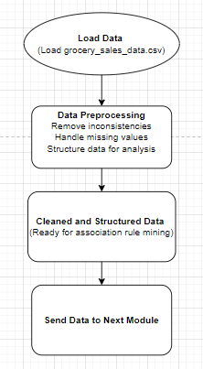
Data Flow Diagram
Final Review
Department of Artificial Intelligence and Data Science

Slide 16
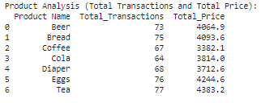
Output Screenshot
Department of Artificial Intelligence and Data Science
Final Review

Slide 17
Module 2 : Associate Rule Mining Module
Step 1: Preprocessed Data
Start with data that has been cleaned and formatted for analysis.
Step 2: Association Rule Mining
Feed this preprocessed data into the association rule mining module.
Step 3: Apriori Algorithm
Within this module, the Apriori algorithm is utilized to identify frequent itemsets and
generate rules from the sales data.
Step 4: Actionable Insights
The output from the Apriori algorithm provides several actionable insights, such as:
- Frequent Product Pairs.
- Analysis of customer purchasing behavior.
- Strategies for shelf placement.

Slide 18
Module 2 : Associate Rule Mining Module
Step 5: Informed Decisions on Shelf Placement & Sales
Use these insights to make well-informed decisions about how products are placed on
shelves and overall sales strategies.

Slide 19
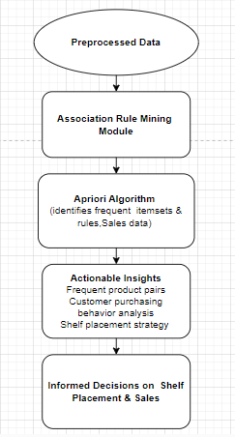
Data Flow Diagram
Department of Artificial Intelligence and Data Science
Final Review

Slide 20
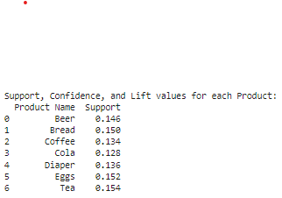
Output Screenshot
Department of Artificial Intelligence and Data Science
Final Review

Slide 21
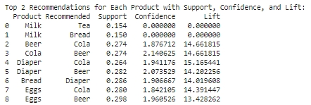
Output Screenshot
Department of Artificial Intelligence and Data Science
Final Review

Slide 22
Module 3 : Visualization Module
Step 1: Preprocessed Data
Begin with cleaned and formatted data, ready for analysis.
Step 2: Association Rule Mining
Feed the preprocessed data into this module.
Step 3: Apriori Algorithm
Within the module, the Apriori algorithm is employed to identify frequent itemsets
and generate rules from the sales data.
Step 4: Actionable Insights
The output from the Apriori algorithm offers several actionable insights, including:
- Frequent product pairs
- Analysis of customer purchasing behavior
- Strategies for shelf placement
Department of Artificial Intelligence and Data Science
Final Review

Slide 23
Module 3 : Visualization Module
Step 5: Visualization & Reporting Module
These insights are then visualized and reported through various charts and graphs,
displaying product performance patterns and providing insights for store managers
and analysts.
Step 6 : Informed Decisions on Shelf Placement & Sales
Finally, these visualizations and reports aid in making well-informed decisions
regarding how products are placed on shelves and overall sales strategies.
Department of Artificial Intelligence and Data Science
Final Review

Slide 24
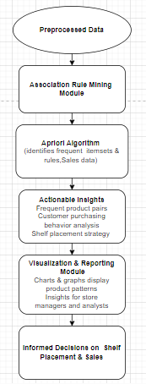
Data Flow Diagram
Department of Artificial Intelligence and Data Science
Final Review

Slide 25
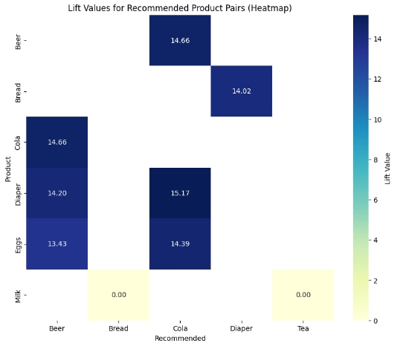
Output Screenshot
Final Review
Department of Artificial Intelligence and Data Science

Slide 26
Module 4 : Monitoring and Adaptaion Module
Step 1: Preprocessed Data
The process starts with preprocessed data.
Step 2: Association Rule Mining
The preprocessed data is fed into the association rule mining module.
Step 3: Apriori Algorithm
Within the association rule mining module, the Apriori algorithm is used to identify
frequent itemsets and rules from the sales data.
Step 4: Actionable Insights
The output from the Apriori algorithm provides actionable insights, including:
- Frequent product pairs
- Analysis of customer purchasing behavior
- Strategies for shelf placement
Department of Artificial Intelligence and Data Science
Final Review

Slide 27
Module 4 : Monitoring and Adaptation Module
Step 6 : Informed Decisions on Shelf Placement & Sales
Thus actionable insights are used to make informed decision regarding shelf
placement and sales.
Step 6 : Monitoring and Adaptation
The system's performance is observed in real-time, and adjustments are made based
on new data. This module adapts to seasonal trends and consumer behavior.
Department of Artificial Intelligence and Data Science

Slide 28
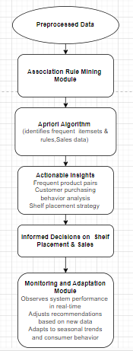
Data Flow Diagram
Department of Artificial Intelligence and Data Science

Slide 29
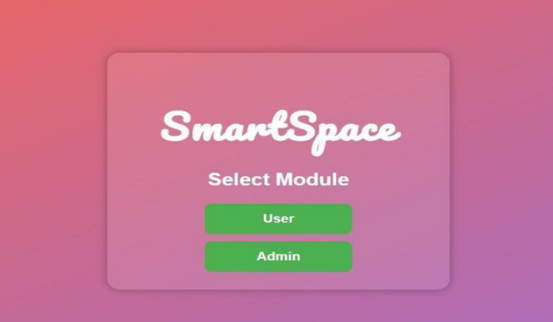
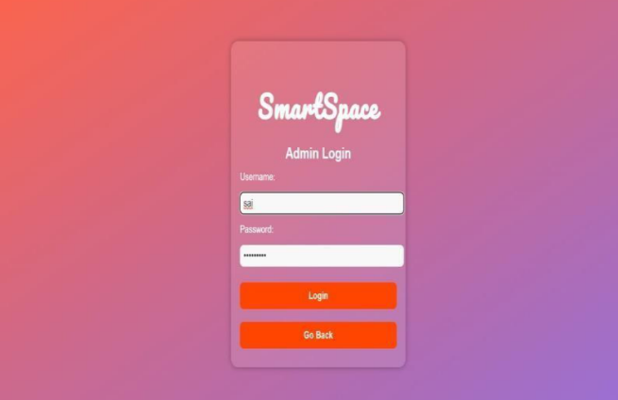
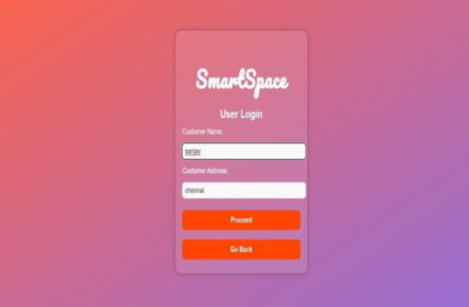
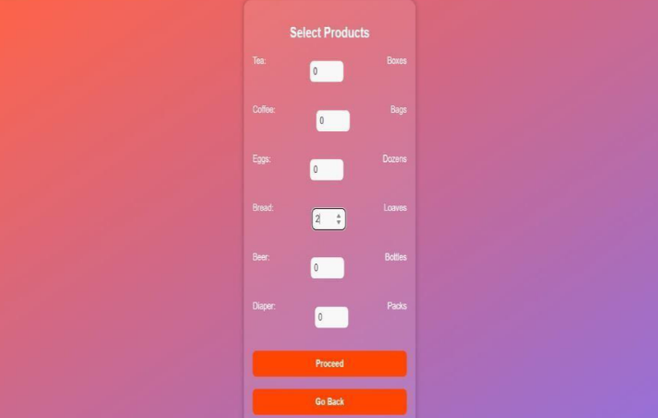
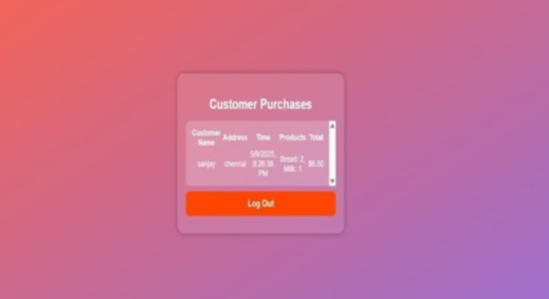
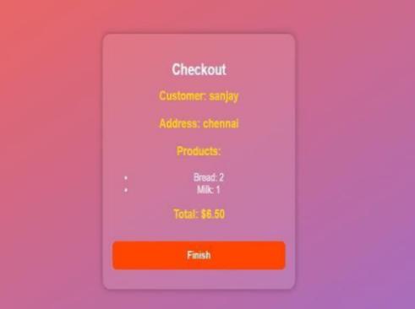
Output Screenshot
Department of Artificial Intelligence and Data Science

Slide 30
Support Formula
Definition: In the Apriori algorithm, support measures how often an item or itemset appears in the dataset as a percentage of all transactions.
Formula:
Purpose
Support helps identify which itemsets are common enough to consider for rule generation. A higher support value means the itemset appears frequently in the transactions. It helps identify frequent itemsets by filtering out items that appear too rarely to be useful.
Department of Artificial Intelligence and Data Science

Slide 31
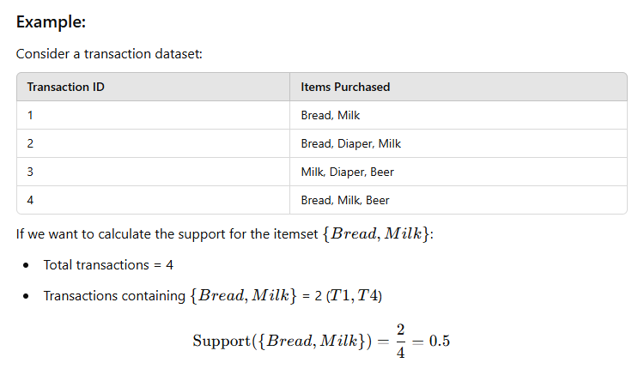
Example for Support
Department of Artificial Intelligence and Data Science

Slide 32

Confidence Formula
Definition: In the Apriori algorithm, confidence measures how often items in a rule are bought together. It is the likelihood that a transaction containing one itemset (the antecedent) also contains another itemset
Formula:
Purpose
Confidence evaluates the strength of an association rule, helping to find strong relationships between items. High confidence means that the rule is likely to be valid.
Department of Artificial Intelligence and Data Science

Slide 33
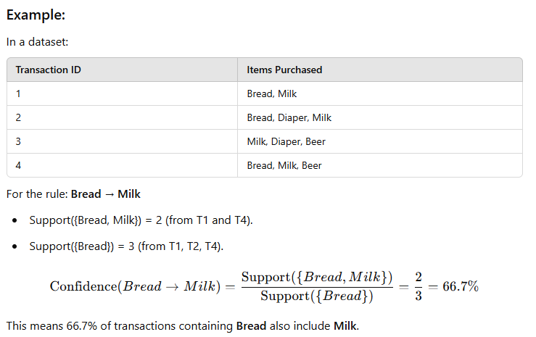
Example for Confidence
Department of Artificial Intelligence and Data Science

Slide 34

Lift Formula
Definition: In the Apriori algorithm, lift measures the strength of an association rule compared to the expected co-occurrence of items if they were independent. It tells us how much more likely the items in the rule are to appear together than by random chance..
Formula:
Purpose
Lift indicates whether the presence of item X increases the likelihood of purchasing item Y.
Department of Artificial Intelligence and Data Science

Slide 35
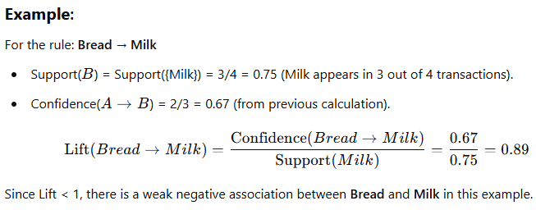
Example for Lift
Department of Artificial Intelligence and Data Science

Slide 36
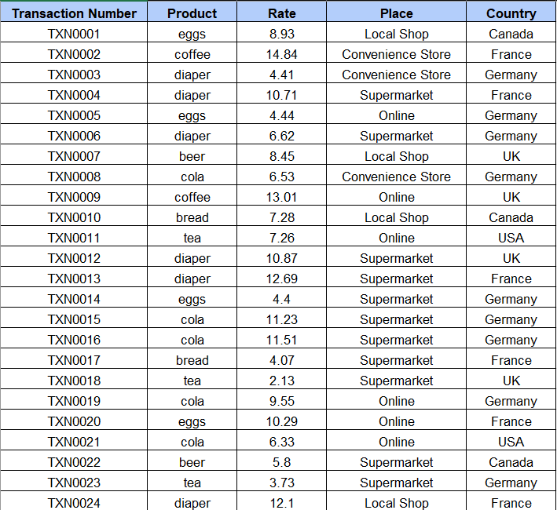
Formula – Excel Sheet
Department of Artificial Intelligence and Data Science

Slide 37
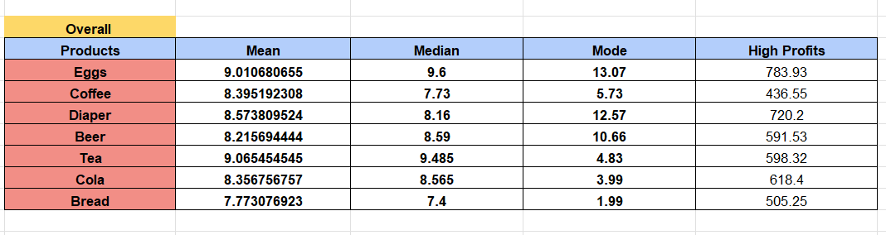
Formula – Excel Sheet
Department of Artificial Intelligence and Data Science

Slide 38
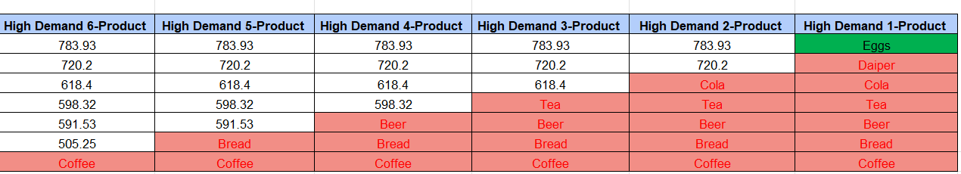
Formula – Excel Sheet
Department of Artificial Intelligence and Data Science

Slide 39
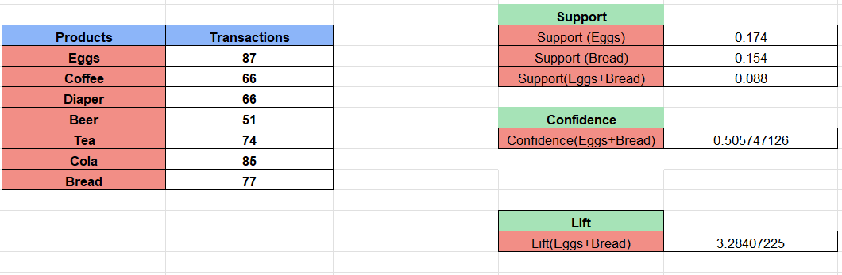
Formula – Excel Sheet
Department of Artificial Intelligence and Data Science

Slide 40
Conclusion
By analyzing sales data and customer shopping patterns, the grocery chain can optimize shelf space utilization to enhance product placement and improve inventory management. Strategic positioning of high-demand items can increase visibility and drive sales, while efficient inventory management minimizes stockouts and reduces overstock. These actions lead to better customer satisfaction, reduced waste, and increased profitability, providing a competitive advantage in the retail market.
Department of Artificial Intelligence and Data Science

Slide 41
References
S. P. Parikh, S. S. Dedhia, and K. V. Padole, "Market Basket Analysis Using Association Rule Mining," International Journal of Computer Science and Information Technologies, vol. 6, no. 2, pp. 1958-1961, 2015.
V. Venkatesan and K. V. N. Sunitha, "Market Basket Analysis for a Supermarket based on Frequent Itemset Mining," in Proceedings of the International Conference on Data Science and Engineering (ICDSE), Cochin, India, 2012, pp. 14-17.
S.-H. Huang, C.-Y. Tsai, and C.-C. Lo, "A Multi-Data Mining Approach for Shelf Space Optimization Considering Customer Behaviour," International Conference on Data Science and Advanced Analytics (DSAA), 2014, pp. 1-8.
Thomas, J. A., & George, S. "Application of Apriori Algorithm in Supermarket Shelf Space Optimization." Proc. IEEE International Conference on Intelligent Computing and Control (I2C2), 2017.

Slide 42
Thank You

